Slide 1
Meta-Rules for Data Visualization
John F. Tripp

Slide 2
Meta-Rules for Data Viz

Slide 3
Meta-Rules for Data Viz
The simplest chart is usually the one that communicates most clearly
  Use the “not wrong” chart
  Not the “cool” chart

Slide 4
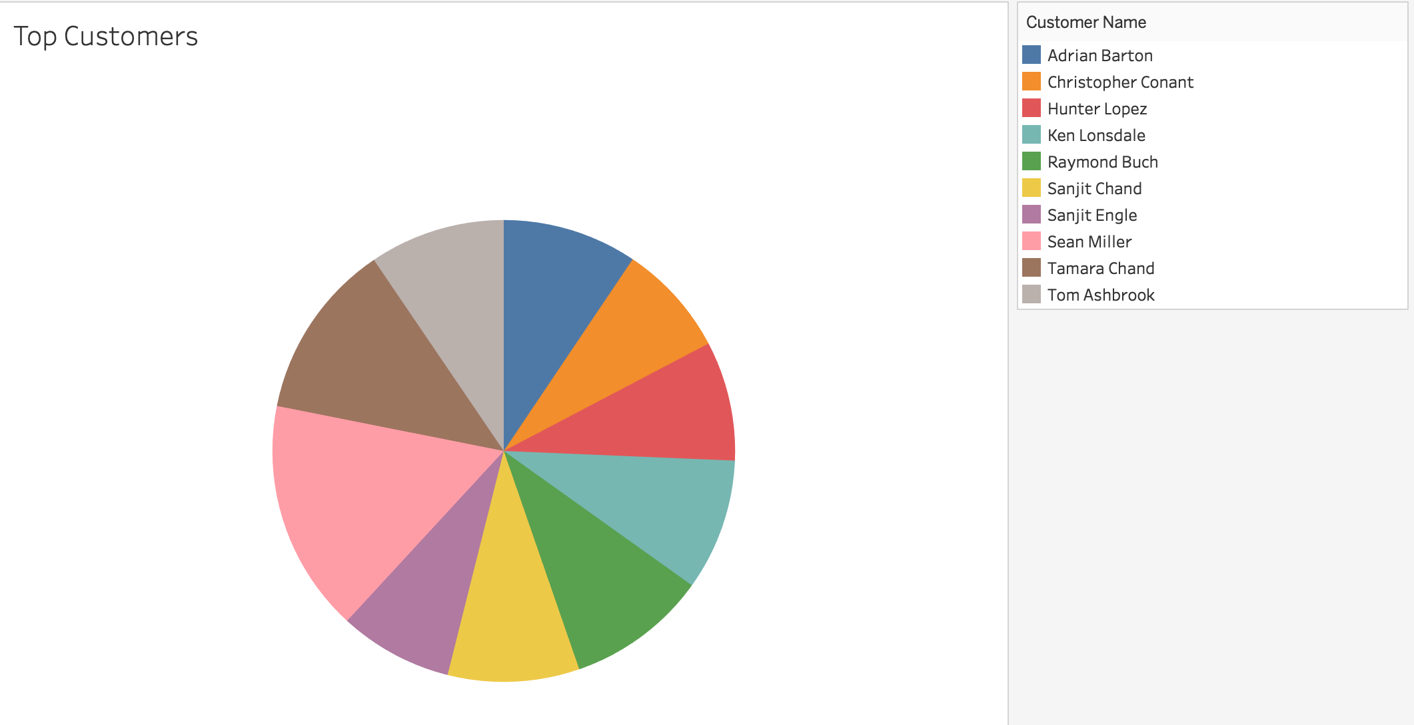
The simplest chart is usually the one that communicates most clearly

Slide 5
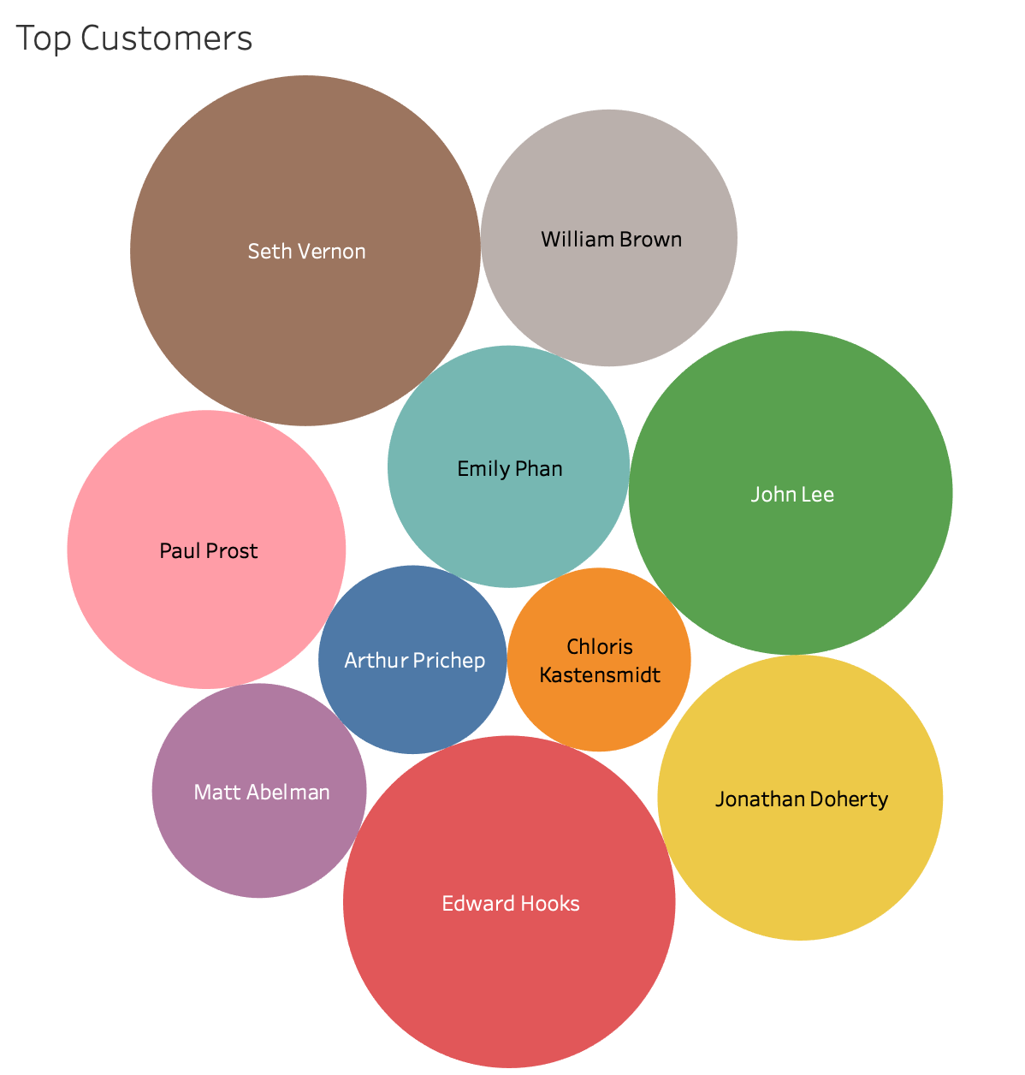
The simplest chart is usually the one that communicates most clearly

Slide 6
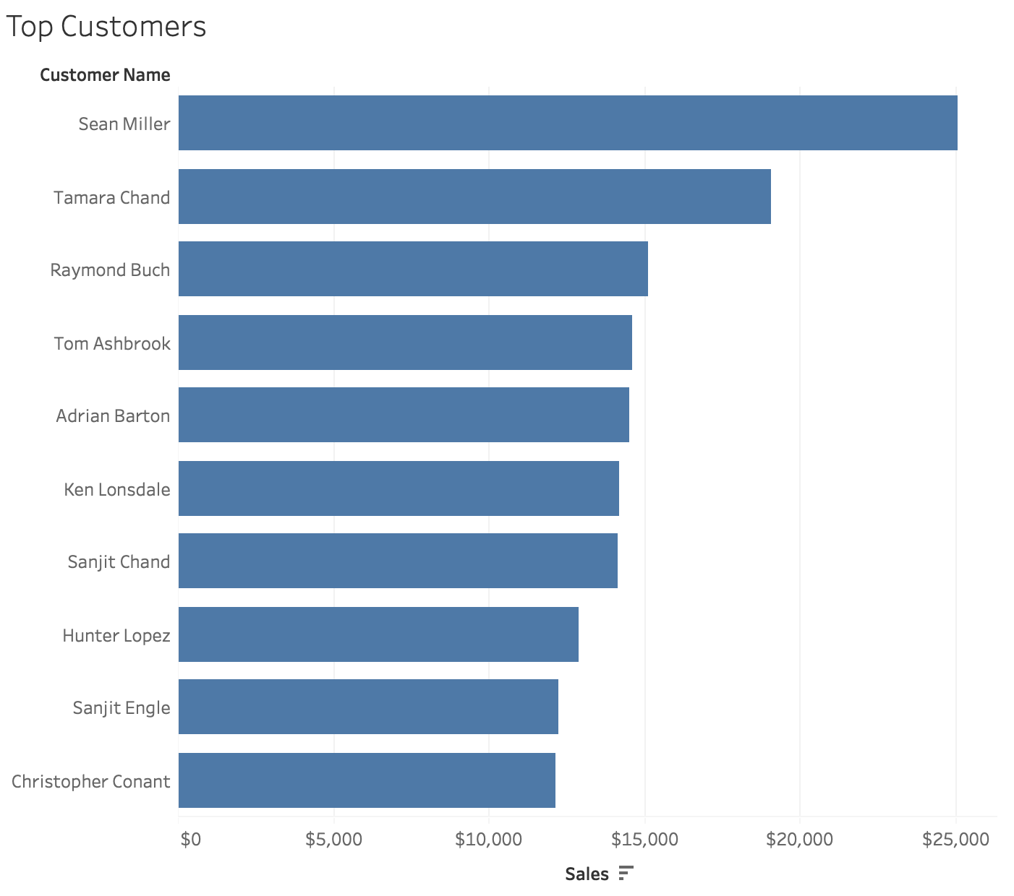
The simplest chart is usually the one that communicates most clearly

Slide 7
Meta-Rules for Data Viz
Always DIRECTLY represent the relationship you are trying to communicate. (e.g., don’t leave it to the viewer to calculate it from other information)

Slide 8
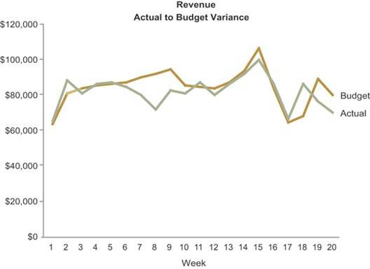
2. Always DIRECTLY represent the relationship you are trying to communicate. (e.g., don’t leave it to the viewer to calculate it from other information)

Slide 9
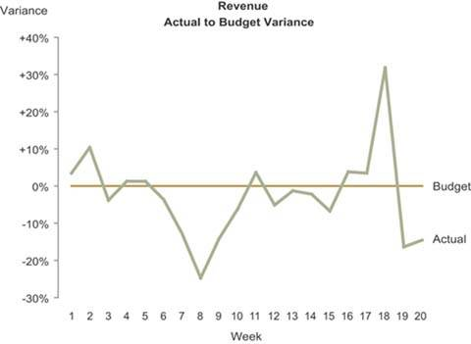
2. Always DIRECTLY represent the relationship you are trying to communicate. (e.g., don’t leave it to the viewer to calculate it from other information)

Slide 10
Meta-Rules for Data Viz
Never ask viewers to compare levels of a single dimension in two dimensions (e.g., comparing differences in length is easy, comparing differences in area is hard)

Slide 11
Never ask viewers to compare levels of a single dimension in two dimensions (e.g., comparing differences in length is easy, comparing differences in area is hard)

Slide 12
Never ask viewers to compare levels of a single dimension in two dimensions (e.g., comparing differences in length is easy, comparing differences in area is hard)
2
1

Slide 13
Never ask viewers to compare levels of a single dimension in two dimensions (e.g., comparing differences in length is easy, comparing differences in area is hard)

Slide 14
Never ask viewers to compare levels of a single dimension in two dimensions (e.g., comparing differences in length is easy, comparing differences in area is hard)
2
1

Slide 15
Meta-Rules for Data Viz
Never use color on top of color. (e.g., color is not absolute)

Slide 16
Never use color on top of color. (e.g., color is not absolute)

Slide 17
Meta-Rules for Data Viz
Do not violate the primal instincts of your viewers. (e.g., up means more)

Slide 18
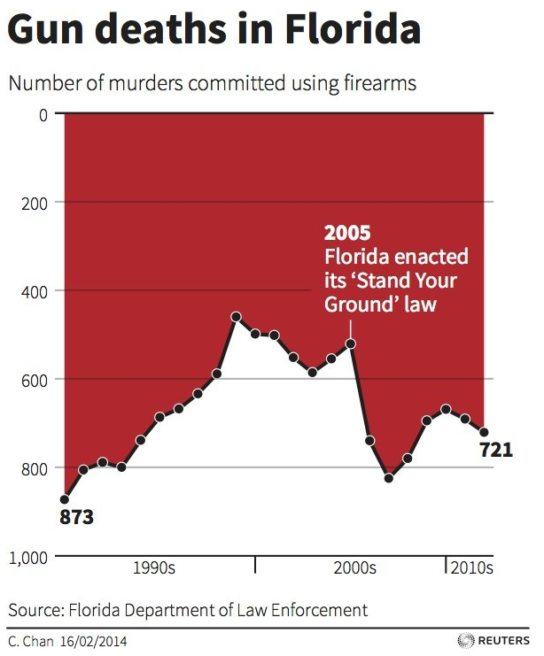
Do not violate the primal instincts of your viewers. (e.g., up means more)

Slide 19
Meta-Rules for Data Viz
Chart with graphical and ethical integrity! (e.g., don’t lie, either by mistake or intentionally)

Slide 20
Chart with graphical and ethical integrity! (e.g., don’t lie, either by mistake or intentionally)

Slide 21
Chart with graphical and ethical integrity! (e.g., don’t lie, either by mistake or intentionally)

Slide 22
Meta-Rules for Data Viz
The simplest chart is usually the one that communicates most clearly (e.g., use the “not wrong” chart – not the “cool” chart)
Always DIRECTLY represent the relationship you are trying to communicate. (e.g., don’t leave it to the viewer to calculate it from other information)
Never ask viewers to compare levels of a single dimension in two dimensions (e.g., comparing differences in length is easy, comparing differences in area is hard)
Never use color on top of color. (e.g., color is not absolute)
Do not violate the primal instincts of your viewers. (e.g., up means more)
Chart with graphical and ethical integrity! (e.g., don’t lie, either by mistake or intentionally)

